Slide 1
Chapter 17

Slide 2
Objectives

Slide 3
Objectives (continued)

Slide 4
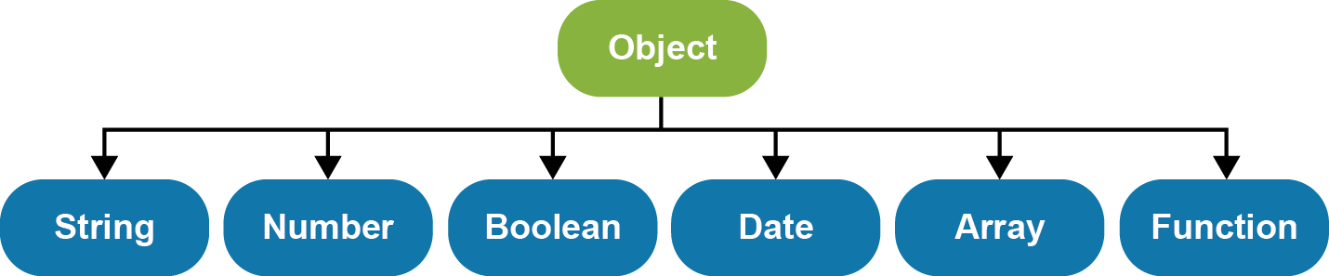
The JavaScript hierarchy of some of the native object types

Slide 5
The syntax for creating a new object of a native type

Slide 6
How to create a new object of a native type with literal values

Slide 7
How to create a new object of a native type with literal values (continued)

Slide 8
How to use the properties and methods of the native object types

Slide 9
How to initialize a new object with properties and methods

Slide 10
How to initialize a new object with properties and methods (continued)

Slide 11
How to nest objects and refer to the nested properties and methods

Slide 12
How to add properties and methods to an object

Slide 13
Two variables that refer to the same object

Slide 14
The benefits of JavaScript libraries

Slide 15
An example of a simple library file (library_mpg.js)

Slide 16
How to include and use JavaScript libraries in your application

Slide 17
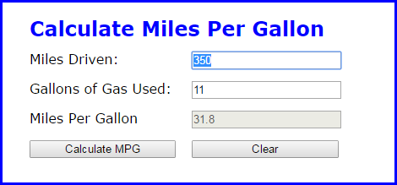
The Miles Per Gallon Application

Slide 18
The HTML for the MPG application

Slide 19
The library_mpg.js file for the MPG application

Slide 20
The main.js file for the MPG application

Slide 21
How to use a constructor function to create an Invoice object type

Slide 22
How to add methods to the Invoice object type

Slide 23
How to create instances of the Invoice object type with two parameters

Slide 24
Code that creates two instances of the Date object type

Slide 25
Code that adds a method to the prototype object of the Date object type

Slide 26
Code that adds an own property to one instance of the Date object type

Slide 27
Terms

Slide 28
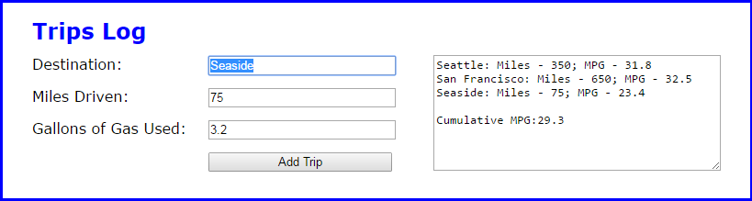
The Trips application

Slide 29
The HTML for the Trips application

Slide 30
The HTML for the Trips application (continued)

Slide 31
Some of the CSS for the Trips application

Slide 32
The library_trip.js file

Slide 33
The main.js file

Slide 34
The main.js file (continued)

Slide 35
The create() method of the Object object

Slide 36
A custom prototype object with one method

Slide 37
A factory function that uses the create() method to create an object

Slide 38
The library_trip .js file for the Trips application with a factory function

Slide 39
The library_trip .js file (continued)

Slide 40
The main.js file for the Trips application with a factory function

Slide 41
The main.js file (continued)

Slide 42
A function that uses the arguments property to get an argument

Slide 43
How to determine the number of arguments that have been passed

Slide 44
An Invoice constructor that accepts a variable number of arguments

Slide 45
An Invoice method that provides a default value for an argument

Slide 46
An instance of Invoice with a tax rate and 3 item codes

Slide 47
Two methods that modify an object but don’t return the object

Slide 48
Two methods that modify an object and then return the object

Slide 49
How to inherit methods using constructors

Slide 50
How to inherit methods using constructors (continued)

Slide 51
How to inherit methods using the Object.create() method

Slide 52
How to inherit methods using the Object.create() method (continued)

Slide 53
The value of the this keyword depends on how the function is invoked

Slide 54
Methods of a function for specifying the value of this

Slide 55
How to use the call() method to borrow a method from the Array object

Slide 56
How to use the bind() method to override this in an event handler

Slide 57
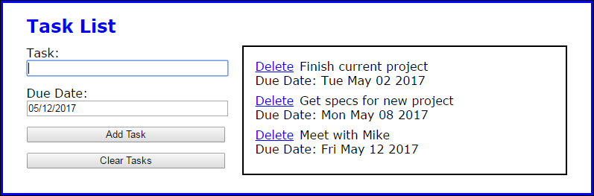
The Task List application

Slide 58
The HTML for the Task List app

Slide 59
The HTML for the Task List app (continued)

Slide 60
Some of the CSS for the application

Slide 61
The library_task.js file for the Task List app

Slide 62
The library_storage.js file for the Task List app

Slide 63
The library_storage.js file (continued)

Slide 64
The library_storage.js file (continued)

Slide 65
The library_tasklist.js file for the Task List app

Slide 66
The library_tasklist.js file (continued)

Slide 67
The library_tasklist.js file (continued)

Slide 68
The main JavaScript file for the Task List app

Slide 69
The main JavaScript file (continued)

Slide 70
Exercise 17-1 Enhance the Task List app

Slide 71
Exercise 17-2 Enhance the Countdown app

Slide 72
Extras: Use objects with the Change Calculator

Slide 73
Extra 17-4 Convert the PIG app to objects

Slide 74
Short 17-1 Enhance the MPG application to use the arguments property

